Slide 1
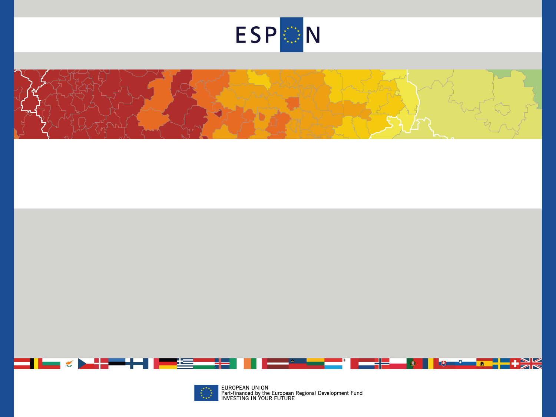
Territorial scenarios for Europe
With special regards to Central European Countries
Roberto Camagni
with R. Capello, A. Caragliu, U. Fratesi
Politecnico di Milano, ABC Department
Hungarian Regional Science Association, 11° Meeting
Kaposvàr, 21-22 November, 2013

Slide 2

Objectives of the presentation
To present results of some research works carried out within the ESPON Programme of the EU, namely:
ET2050: development scenarios for European Regions (2013)
KIT: Knowledge, Innovation and Territory (2011-12)
Span: Spatial Scenarios for the Latin Arc Countries (2008-09)
To produce “quantitative foresights” (not forecasts) based on conditional scenario assumptions for all European regions up to 2030, with special reference to Central Eastern Countries
To present some early reflections on development policies

Slide 3
Introduction
Over the last few years, the world economy has gone through a severe period of economic downturn, the worst since the end of the second world war.
If the overall magnitude of the effects generated by the crisis is not yet fully understood, even less clear is the spatial distribution of these effects.
This explains the importance of the use of macroeconomic regional econometric and forecasting models.

Slide 4
Introduction
Regions belong to different nations with different exposure to the crisis.
Regions have different industrial specialization, as well as different capacities to exploit untapped resources, or territorial capital assets.
Macroeconomic demand side effects have different impacts :
- on national economies, according to their different level of public debt and deficit, and development potential,
on the different regions, according to their consumption patterns, type of demand (public vs. private) and productive specializations.
Financial speculation determined a differentiated rise in the spread on public bonds in different countries, exacerbating the cost of the debt service, raising public deficits, generating huge effects on public spending at central and local levels.

Slide 5
Introduction
A strong control on public expenditure and on its reduction was imposed by the EU, especially to “vicious” countries. The effects of such a reduction are expected to be stronger in those regions with a higher share of public demand with respect to the private one, being generally the poorer and less productive regions;
in “vicious” countries, private investments decreased as a consequence of the increase in interest rates, penalizing private actors, and particularly productive regions;
a credit crunch came as a consequence of the financial intermediaries’ decision to prefer financial investments on public bonds, when guarantees existed on sovereign default; the real sector and the most productive regions hosting it were once again penalized more than others.
In general though, is difficult to predict which regions were hit more.

Slide 6
The foresight tool: the MASST3 model
MASST is an econometric forecasting model. Previous versions of MASST developed for ESPON 3.2; ESPON SPAN; DGRegio projects.
The ET2050 project is based on a new version of MASST, considering the economic crisis (two periods of model estimation), public budget constraints, innovation modes, the role of urban areas in regional growth.
The model is able to simulate effects on regional growth of:
the economic crisis;
macroeconomic elements (public budget constraints, sovereign debt, spread in interest rates of public bonds, exchange rates);
territorial capital elements (innovativeness, trust, accessibility);
cohesion and infastructure policies.

Slide 7
The model
The logics of the model is at the same time Top-down & Bottom-up (i.e. distributive and generative):
national growth (determined by macro-economic elements: demand side) is distributed among regions,
but regions add a “differential” effect (determined by presence of territorial capital: supply side) able to feed-back on national performance.
Quantitative foresight is produced for all NUTS2 regions of all 27 EU countries (270 regions).

Slide 8
The MASST3 model:

Slide 9
Scenario Assumptions
structural breaks brought in by the crisis are considered, due to emerging global contradictions:
Stop to demand based on debt in advanced countries,
Financialization of western economies and related risks,
China and BRICs supporting western real income (through low-price exports) and financing the trade deficit of USA : persisting?
By consequence, in the future:
the balance of the geo-political game will be different;
winning assets will be different;
spread in interest rates proportional to sovereign debts;
necessary (but probably too high) austerity measures imposed on public deficits by the EU.

Slide 10
Scenario Assumptions
b) “Regionalized” globalization, with the large “triad” areas (Europe, America, East and South Asia) more independent and more internally integrated
BRICs enter progressively in the medium and high technology game
- The growth of real income in Europe will be more modest;
- “Regionalized” globalization processes will enable the recovery of manufacturing activities in Europe (and the US);
A number of new technologies will develop: nanotech, biotech, transport technologies, new materials
c) More importantly: a new paradigm will emerge: the “green economy”, due to increasing energy prices and growing concern about climate change. Many sectors touched: manufacturing, energy, transport, building and construction, tourism, agriculture (zero-km)
Provides a new demand source, new jobs and a reduction in dependency on fossil fuels
It may boost a revival of endogenous growth in Europe

Slide 11
Scenario Assumptions
d) Regional disparities are likely to increase (two speed growth)
Metro regions will host the advanced activities and R&D
New manufacturing activities, benefiting from technological progress, will also locate in metro and second rank cities
e) Austerity measures will endanger growth in “vicious” , mainly southern European countries: for some times, “internal devaluations”, severe cuts in public spending and difficulties in financing private investments will determine a cumulative divergence with respect to stronger countries.
All these elements can be easily accomodated into the MASST model, thanks to the new inclusion of sectoral regional structures and constraints coming from national sovereign debt and public budget disequilibria.

Slide 12
Scenario Assumptions
Concerning Central - Eastern European Countries:
Catching up in productivity with respect to Old 15 Countries will continue, but possibly at a lower rate due to:
FDI dependency: they will slowly redirect towards outer eastern countries and towards trade and commercial functions, in order to benefit from increasing internal incomes (in CEECs),
Difficulty in keeping low levels of inflation, due to difficulty in keeping wage increases in line with productivity increases,
Outflows of profits by multinational companies,
Slow taking-off of an endogenous accumulation of capital.
ii) Difficulty in finding a more advanced innovation “pattern” with respect to the present one (mainly an “imitative innovation pattern”, driven by FDI, with an internal dualist industrial structure).

Slide 13
Past trends in productivity

Slide 14
Past trends in FDI inflows (absolute values)

Slide 15
Past trends in FDI (% on GDP)

Slide 16
Trends in competitiveness
Real Effective Exchange rates for the NMS, 1994-2012

Slide 17
Assumptions of the Baseline Scenario
- the socio-economic and demographic trends of the past will continue, and no major change will come to alter the EU economy;
economic policies will remain the present ones;
a general slow economic recovery will start in 2016;
a slight increase in competitiveness of European countries is assumed in 2030;
By 2030 interest rates on bonds will return back to lower, pre-crisis values, thanks to the end of strong speculation;
the stability pact remains the same, still imposing highly restrictive public budget policies.

Slide 18
RESULTS FOR THE
BASELINE SCENARIO
(2030)

Slide 19
Aggregate results of the Baseline scenario
 | Average annual GDP growth rate | Average annual population growth rate | Average annual employment growth rate | Average annual manufacturing employment growth rate | Average annual service employment growth rate
EU27 | 1.89 | 0.31 | 1.58 | 1.38 | 1.63
Old 15 | 1.88 | 0.47 | 1.53 | 1.48 | 1.54
New 12 | 1.93 | -0.38 | 1.90 | 0.98 | 2.33
1. The New12 countries grow a little more than the Western countries.
2. New12 countries increase employment in services more than in manufacturing, entering a new stage of development.
3. Western countries have a balanced growth between manufacturing and services.

Slide 20
Baseline: annual average GDP growth rate
Two speed Europe; Southern peripheral countries grow less than Northern countries.
Southern European countries discount the difficult present conditions on their future evolutionary trajectories.
Eastern European countries still grow more than the EU 15, but this is not enough to catch up the GDP per capita levels of the Western countries in 2030.
Overall intra-national regional disparities increase.

Slide 21
Theil index in the Baseline scenario
Total regional disparities
Inter-national disparities
Intra-national disparities

Slide 22
EXPLORATORY SCENARIOS
(2030)

Slide 23
Summary of assumptions for the exploratory scenarios
“Megas” scenario
Market driven scenario; welfare system fully privatized; financial debt repaid in 2030; budget reduced for cohesion policies; concentration of investments in European large cities.
“Cities” scenario
Public policies mostly at national level; actual welfare system reinforced through increased taxation; financial debt not fully repaid in 2050; budget maintained for cohesion policies; concentration of investments in second rank cities.
“Regions” scenario
Social policies; strong public welfare system; financial debt repaid in 2050; budget significantly increased for cohesion policies; concentration of investments in rural and cohesion areas.

Slide 24
Aggregate GDP growth results for the exploratory scenarios
Aggregates | Baseline | Megas | Cities | Regions | Megas vs. baseline | Cities vs. Baseline | Regions vs. Baseline
EU27 | 1.89 | 2.22 | 2.31 | 1.82 | 0.33 | 0.42 | -0.06
old15 | 1.88 | 2.22 | 2.31 | 1.81 | 0.34 | 0.43 | -0.07
new12 | 1.93 | 2.22 | 2.23 | 1.98 | 0.29 | 0.30 | 0.05
1. The “Cities scenario” is the most expansionary: territorial capital and the urban system are better exploited than in the other scenarios.
2. This holds also for New 12 countries.
3. New 12 countries are those that gain in the regions scenario with respect to the baseline.

Slide 25
Theil Index by Scenario: Total Regional Disparities

Slide 26
Theil Index by Scenario: Between Countries Disparities

Slide 27
Theil Index by Scenario: Inside Countries Disparities

Slide 28
GDP growth rates in the Megas scenario:
differences with respect to the baseline
In Western countries:
strong advantages to rich and central regions;
rural areas of rich regions gain relatively less;
relatively poor countries (like Greece) take advantage of a general increase in demand.
In Eastern countries:
- relatively more diffused growth, thanks to a general recovery of the EU economy.

Slide 29
GDP growth rates in the Cities scenario:
differences with respect to the baseline
In Western countries:
more widespread and diffused growth at intranational level;
strong countries like Germany, the Netherlands, Austria, increase less than Southern countries (catching-up).
In Eastern countries:
diffused advantages, relatively less pronounced than in Western;
similar increase in growth than in the megas scenario.

Slide 30
GDP growth rates in the Regions scenario:
differences with respect to the baseline
Central/core regions grow less than in the baseline scenario.
Rural or peripheral areas gain relatively more than in the baseline scenario.
This holds for both Western and Eastern countries.

Slide 31
A sensitivity analysis on disparities
Several analyses on sensitivity of total disparities were to macro-economic assumptions in the baseline scenario were run.
The most relevant and interesting:
Removing the assumption of a persistence of higher inflation rates in CEECs with respect to western countries, a higher GDP performance appears in CEECs (mainly due to higher exports and lower imports) and by consequence a much lower increase in total regional disparities in 2030.

Slide 32
Conclusions
Difficult times ahead for inter-regional disparities
(due to centralization trends, macroeconomic constraints), confirmed by the recent DG Regio “webminar”
2. A scenario supporting “cities” (first, second and possibly third rank cities) looks the most desirable: in terms of growth potential (best use of “concentrated diffusion” of territorial capital) and in terms of territorial cohesion
Relevant policy tasks for CEECs:
keep wage and price increases in line with productivity growth
launch a wave of endogenous capital accumulation
Find a new “innovation pattern”, based on a “smart” specialization and on selected inter-regional cooperations.

Slide 33
THANK YOU VERY MUCH
FOR YOUR ATTENTION!

