Slide 1
ESPON TIPSE – Applied Research 2013/1/24
Territorial Dimensions of Poverty and Social Exclusion in Europe
Gergely Tagai
Institute for Regional Studies, MTA KRTK
MRTT Conference – Kaposvár
21-22. November 2013

Slide 2
Poverty and social exclusion in European cohesion policy
For promoting a smart, sustainable and inclusive growth, the Europe 2020 strategy has set different main areas of cohesion
Key challenges: tackling with difficulties related to
  Employment
  Innovation
  Climate change
  Education issues
Reducing poverty and social exclusion
For a better targeting in the combat against poverty and social exclusion the knowledge on territories confronted with high degrees of the phenomena is essential

Slide 3
The ESPON TiPSE project
ESPON TIPSE project aims at bringing a better understanding on the territorial dimensions of poverty and social exclusion in European regions
Project tasks focus on:
  Evaluation and interpretation of conceptual approaches related to poverty and social exclusion
  Elaboration of usable measures, finding and mapping robust indicators
  Analysing spatial patterns of poverty and social exclusion
  Carrying out case studies with a qualitative approach to have a larger view on micro-spatial patterns
By considering these issues the most relevant spatial patterns of poverty and social exclusion in Europe can be identified

Slide 4
The conceptualization of social exclsuion
Poverty is basically a relatively narrow income based concept related to the lack of resources
Social exclusion – A process (rather than a state) leading to different forms of exclusion from the society
Social exclusion is multi-dimensional → a multi-dimensional and multi-sectoral analysis of economic, social and political aspects of vulnerability is needed to understand the spatiality of the phenomenon
Four overlapping and interrelated domains (with further sections) are defined: earning a living, access to basic services, social environment, and political participation
Strong performance on several subsets of these domains would show a level of possible or existing social inclusion, while weak performance on several of these subsets indicate an existing condition or being at risk of social exclusion (Talbot et al. 2012)

Slide 5
Domains, dimensions and the number of mapped indicators in social exclusion analysis
Domain identified by WP 2.1 | Dimension recommended by WP 2.6 | Number of indicators (excluding census 2011 data)
Earning a living | Income earned by tax payers | 2
 | Employment | 27 (17 Census / 10 LFS)
Access to basic services | Health | 3
 | Education | 2
 | Housing | 6
Social environment | Age | 3
 | Ethnic composition | 1
 | Immigrants | 1
 | Household structure | 4
Political participation | Citizenship | 1

Slide 6
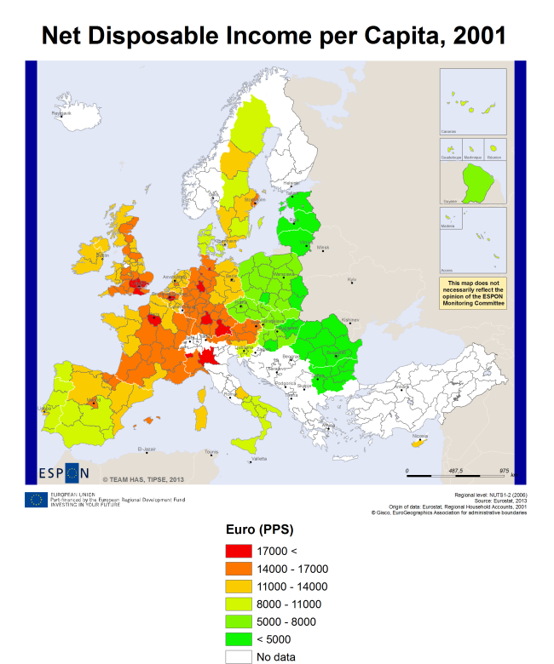
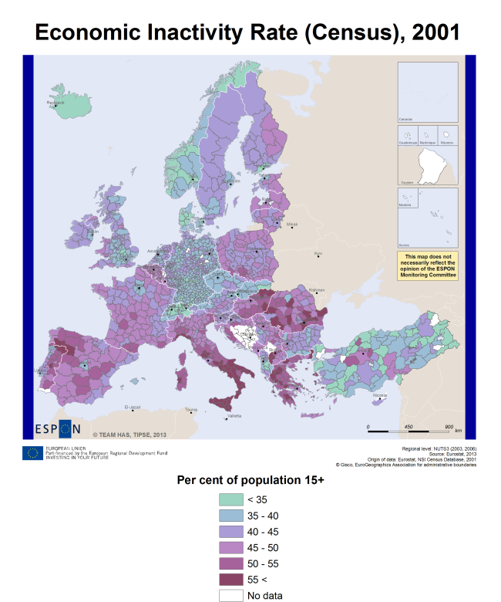
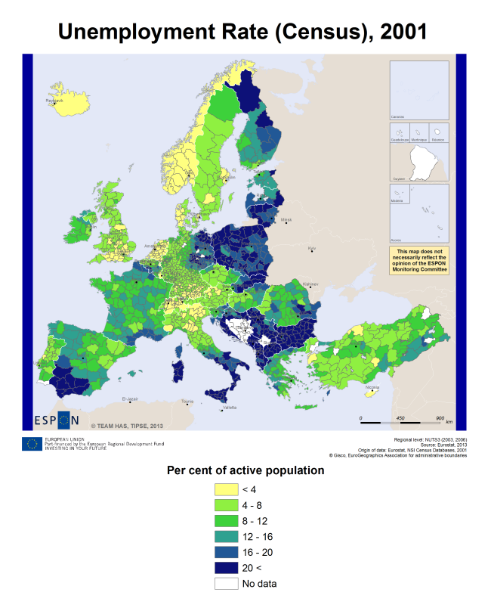
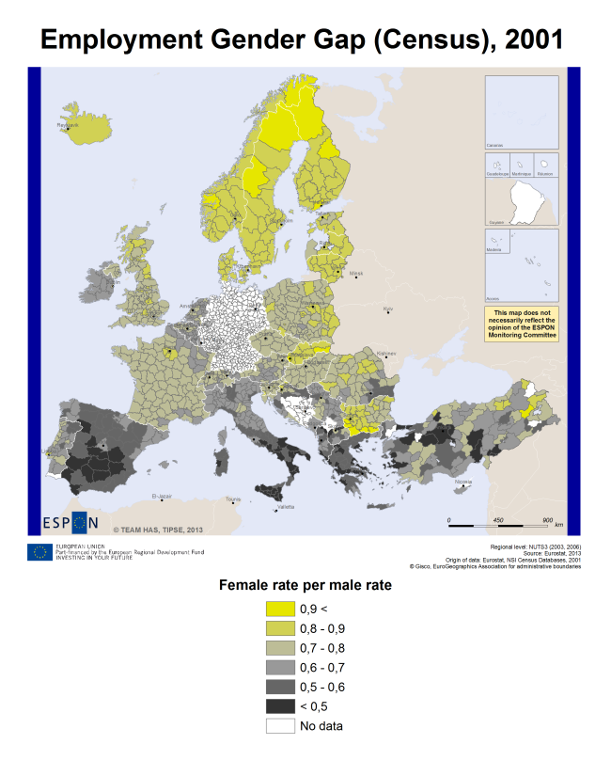
Earning a living
Income
  Disposable income
  Elementary occupations
Employment
  Activity
  Inactivity
  Employment
  Unemployment
  Youth unemployment
  Gender gaps

Slide 7
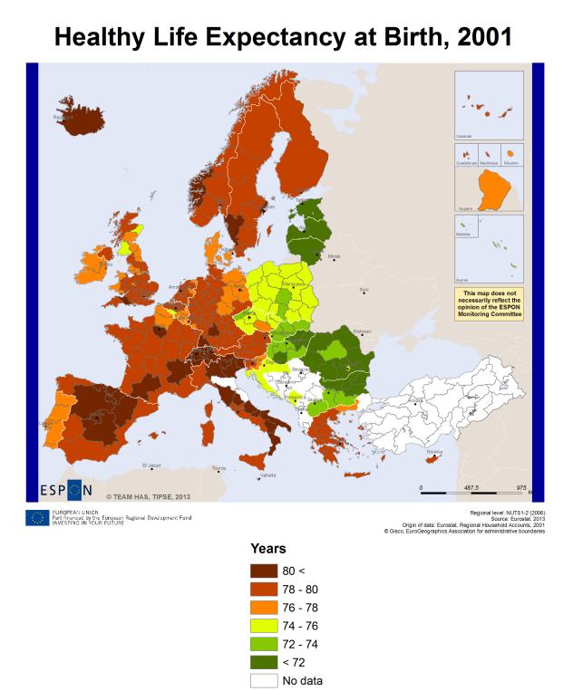
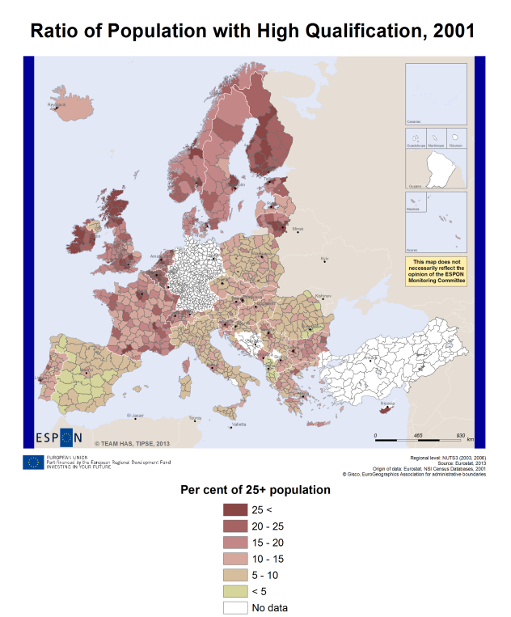
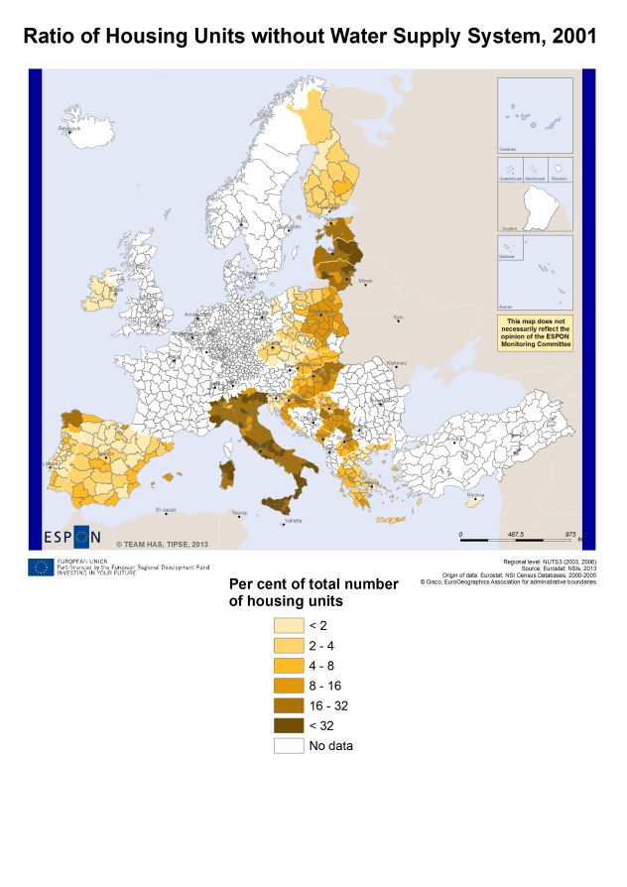
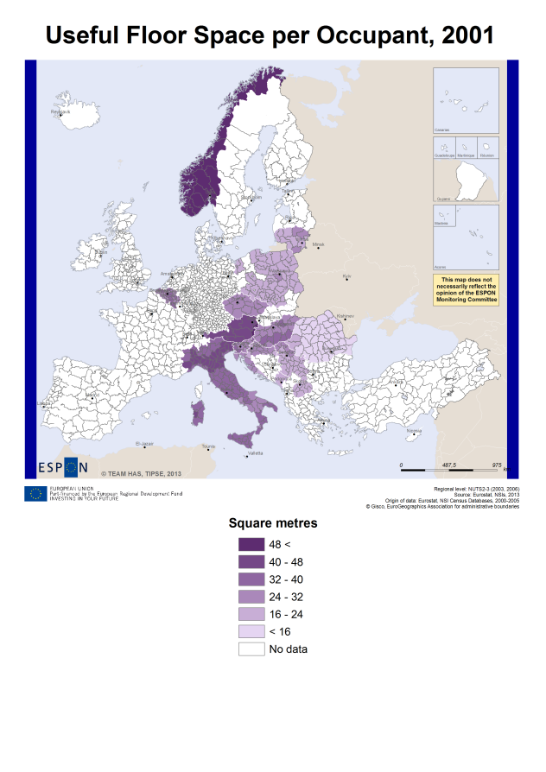
Access to services
Health
  Health services
  Expectations for a healthy life
Education
  Low qualification
  High qualification
Housing
  Installations (water,
  bath-room, central heating)
  Room number
  Floor space

Slide 8
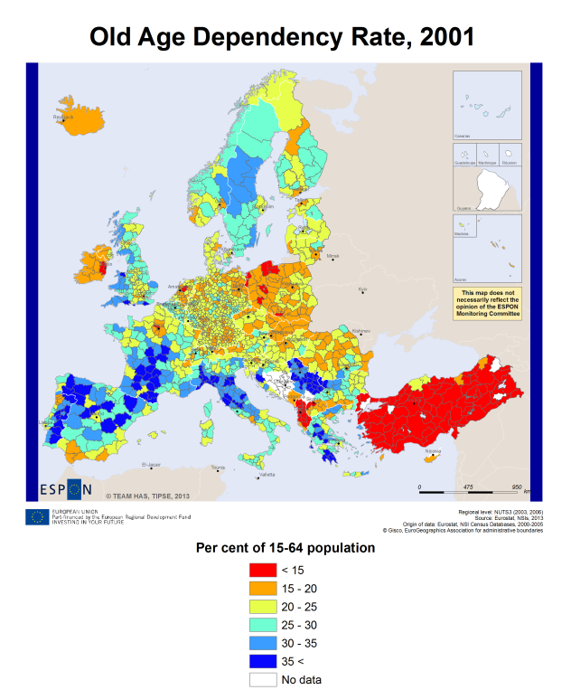
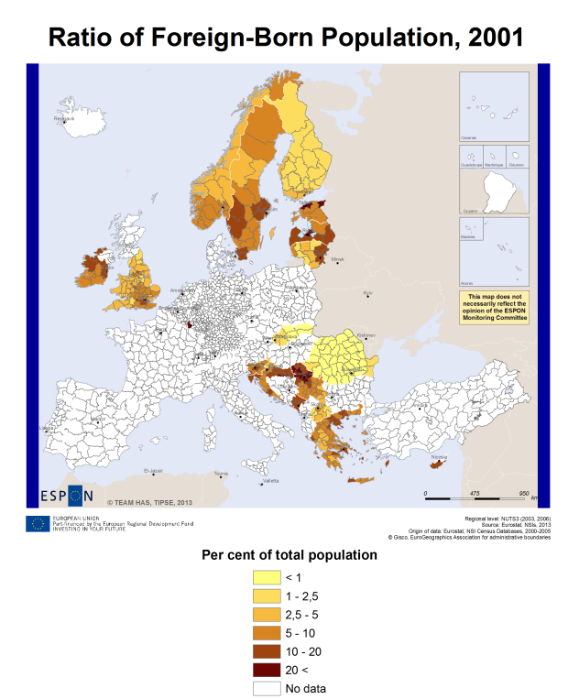
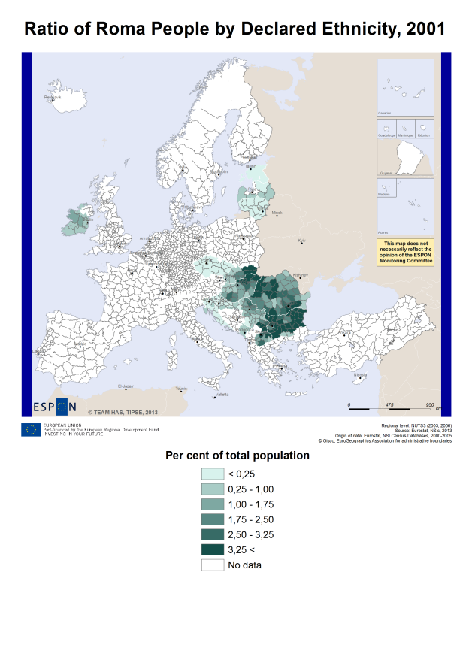
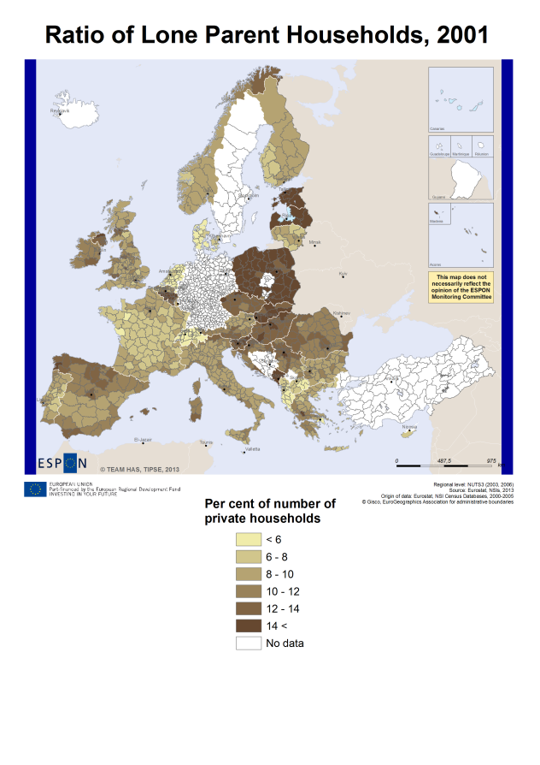
Social environment
Age
  Dependecy rates
Immigration
  Foreign-born population
Ethnic composition
  Roma population
Household structure
  Lone-parent households
  Household size
  Overcrowded households

Slide 9
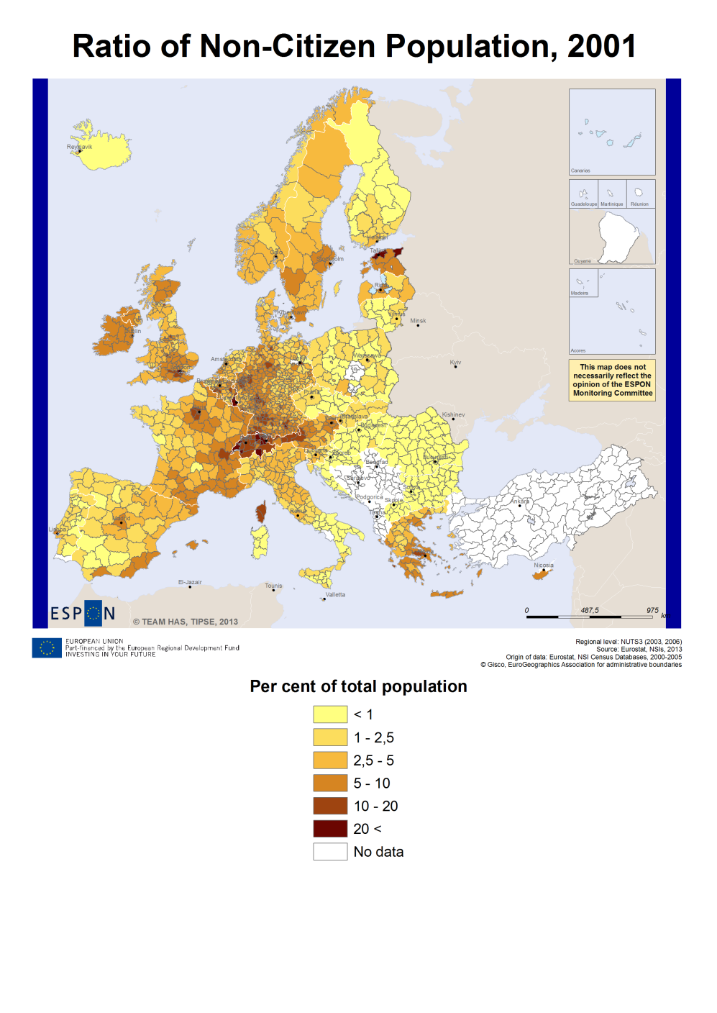
Political participation
Citizenship
  Non-citizen population

Slide 10
Spatial patterns of social exclusion in Europe
Main types of geographical patterns of exclusion with strong but often interrelated (and overlapping) features were identified:
Differences between macro-regions – caused by the differences of social and economic processes, often influenced by cultural effects too;
Urban–Rural disparities – differentiating between urban areas and rural zones on the ground of the vulnerability to various factors influencing SE;
Different patterns of peripherality – highlighting the role of favourable or unfavourable relative location beyond the urban–rural dichotomy;
Place specific patterns of social exclusion – identifying local depression areas affected by multiple dimensions of exclusion (or in other cases, proof against exclusion)

Slide 11
Differences between macro-regions
Snapshots of long-term development paths of countries (economic situation, quality of social infrastructure and environment)
Different nature of European welfare regimes
  How given socio-economic conditions generate social exclusion?
  Vulnerability of certain social groups to unfavourable life situations
  Answers given by national and regional policies (care for dependents, distribution of supports and benefits, terms of access to services and institutions etc.)
Eastern Europe – Western societies and economies
  Long-term lag behind Western Europe, legacies of social and economic transformation of 1990s
  Weaknesses of social institutions (low representation of civil society, defects of social security)
  Disadvantages of earning a living and labour market conditions
  Unfavourable participation rates in economic activity (lower level of employment, high unemployment and inactivity rates)
  Quality of human capital (low qualification)
  Worse housing conditions (facilities and installations), challenges of social environment (lone parent households, Roma population)
  Lower expectancy for a healthy life

Slide 12
Urban–Rural disparities
Unfavourable conditions in urban areas related to SE factors:
  Higher rates of inactivity in cities – ageing population, outmigration (Poland)
  Old age dependency rates are high (e.g. Bulgaria, Slovakia, Hungary, Poland)
  Lone parent families are more common in urban areas
  Ratio of urban Roma population is relatively high in some countries (Balkan countries, Romania, Hungary, Slovakia)
Unfavourable conditions in rural areas according to exclusion symptoms:
  Lower income
  Less favourable labour market participation conditions
  Gender related differences are also more clean-cut
  Multiple disadvantages related to access to services
    Health infrastructure (expectations for a healthy life)
    Higher rates of less qualified population
    Less established housing infrastructure (facilities and installations)
  Rural character of overcrowded households (in some macro-regions it is less prevalent)
  Vulnerable social groups: Roma population

Slide 13
Different patterns of peripherality
Spatial patterns of peripherality often overlap with rural ones
Remote areas (‘isolation’ from urban centres)
  Lack of sufficient opportunities of participating in the labour market (higher rates of unemployment and inactivity)
  Access to education services (lower qualification) or to adequate housing conditions
Physical-geographical factors of peripherality (mountainous, coastal character)
  Mountainous regions – symptoms of exclusion are similar to remote regions
  Remote coastal regions (unfavourable accessibility of in-country centres, insufficient external relations)
  Coastal urban areas (urban factors of exclusion, entering point of immigrants, but positive effects of being a hub in a network)
Border regions affected by social exclusion factors
  Entering points of immigration – (less in Eastern Europe – weak permeability of borders)
  Borders still separate national economies – border regions are often remote peripheries within a country, worse opportunities of earning a living – higher rates of inactivity or unemployment

Slide 14
Place specific patterns of social exclusion
Patterns that do not fit into the above mentioned structures (however sometimes they are interrelated)
Consequences of multiple disadvantages outlining impoverished, depression areas
  Recognizable spatial structure of inequalities within countries
  They are often influenced by continental differences – West-to-East slopes in Eastern European countries
  Unique, place specific disadvantaged features of different areas
    E.g. regions in industrial transition
    Long-lasting impacts of post-war interventions (relocation of ethnicities) – Balkans, but Poland or the Czech republic too (WW II)
  Exclusion symptoms of depression areas boost each other (weak local economy-low employment capacities-higher unemployment and inactivity-precarious living-inadequate housing conditions-lower expectations for a healthy life etc.)

Slide 15
Place specific patterns of social exclusion
Some place specific patterns outlined by SE indicators are related to cultural / traditional differences or climatic specifities
Inadequate housing conditions?
  Different technological conditions
  Climatic endowments
  Size of housing units
Traditional household characteristics
  Traditional family patterns
  Religion-related commitments
Feedback about the usability of indicators (Do these characteristics indicate vulnerability to exclusion?)

Slide 16
How does it serve EU2020 goals?
Results of analyses of social exclusion, spatial patterns revealed by poverty measures and the qualitative, micro-scale case studies will be feed into a complex evaluation of the phenomena
A policy matrix will be set up by TiPSE project group
Policy questions:
  Which territories are confronted with high degrees of poverty or social exclusion?
  What policy recommendations follow from a territorial analysis of poverty and social exclusion?
  How can poverty and social exclusion be monitored at territorial level?

Slide 17
ESPON TiPSE transnational project group
Nordic Centre for Spatial Development, SE
University of the Highlands and Islands, UK
Newcastle University, UK
Research Centre for Economic and Regional Studies, Hungarian Academy of Sciences (Institute for Regional Studies), HU
ILS - Research Institute for Regional and Urban Development, DE
National Centre for Social Research, GR
James Hutton Institute, UK

