Slide 1
Regional effects of economic boom and recession in the Visegrad Countries
‘Polarisation! Why and to what extent is it a problem?’
Central and South East Europe
and the New EU cohesion policy
KUTTOR, Dániel & ZAHORCSÁK, Zsolt
University of Miskolc,
Department of Regional Economics
Institute of World and Regional Economics
22nd November 2013
KAPOSVÁR, MRTT Vándorgyűlés

Slide 2
Content
Introduction
Macro trends in V4 and main drivers
Concept of interaction between macro and mezzo levels
  Test
Descreptive statistics on polarisation
Introduction of role of urban areas
Conclusion

Slide 3
Different trajectories; i.e. the periods of boom and recession
GDP annual growth rates %
GDP added 2000 >> 2014
European Union: x+19,2 %
Czech Republic: x+ 38,7 %
Hungary: x+ 24,6 %
Poland: x+ 50,8 %
Slovakia: x+ 56,4 %

Slide 4
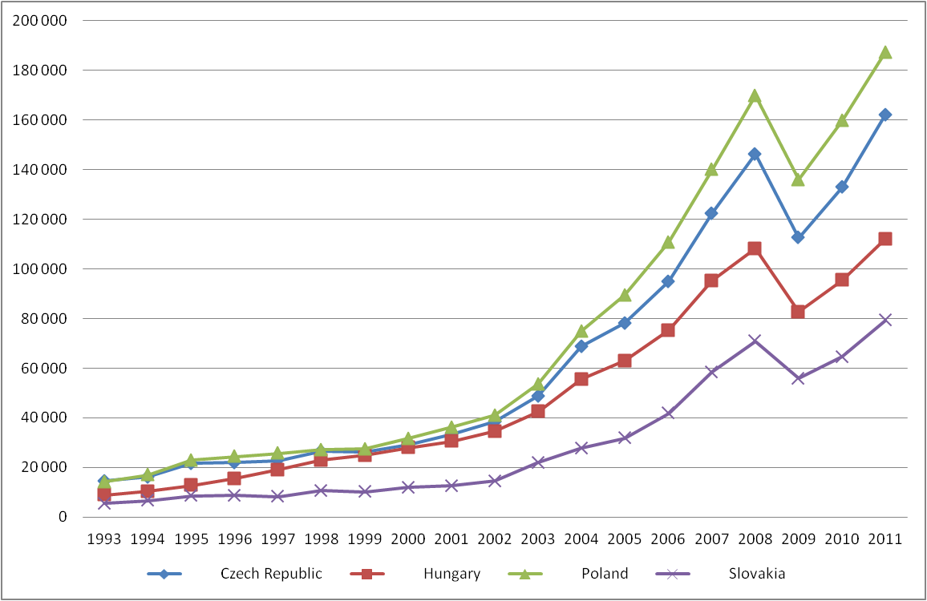
What have been the drivers?
Export volumes by countries
Millions $
Source: UNCTAD STAT data, own compilation .

Slide 5
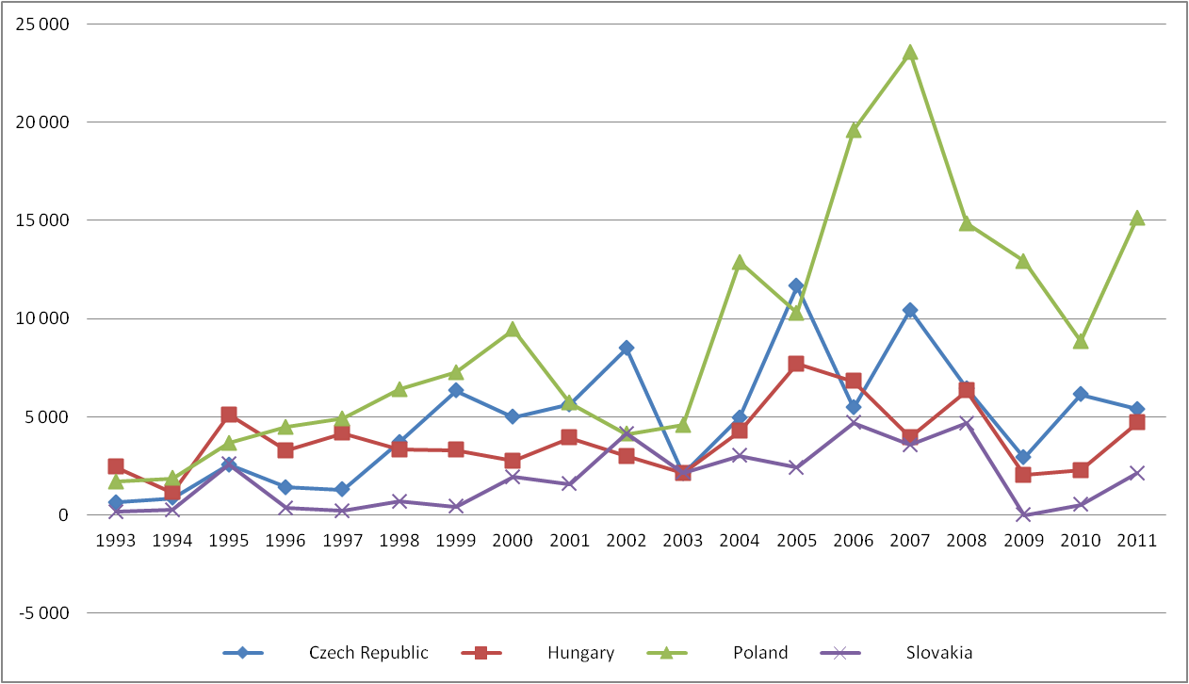
What have been the drivers?
FDI volumes, inflow, by countries
Millions $
Source: UNCTAD STAT data, own compilation .

Slide 6
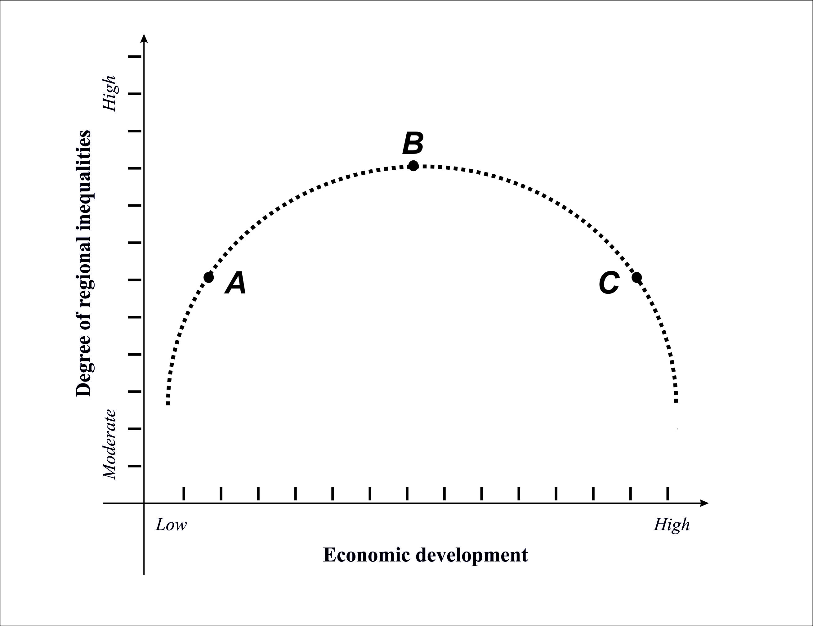
Concept on
economic growth and spatial differentiation
J. G. Williamson (1965)
‘Inverted U’ hypothesis

Slide 7
Testing the Williamson ‘Inverted U’ hypothes
Standard deviation of regional GDP per capita figures, by countries
Std. Dev.
CZ
SK
PL
HU
GDP pc (EUR, PPP)
Source: EUROSTAT data, own compilation .

Slide 8
Major territorial tendency: polarisation!
But three sections with different characters
Mean and standard deviation of regional GDP per capita figures
%
Source:
EUROSTAT data, own compilation .

Slide 9
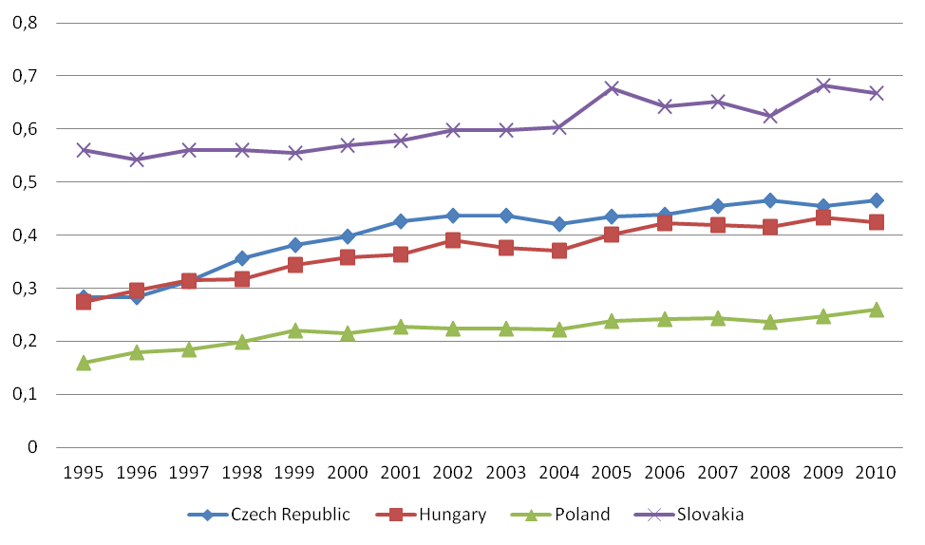
Significant differences among V4 countries,
both aspects (speed and degree)!
Standard deviation of regional GDP per capita figures, by countries
(%)
Source: EUROSTAT data, own compilation .

Slide 10
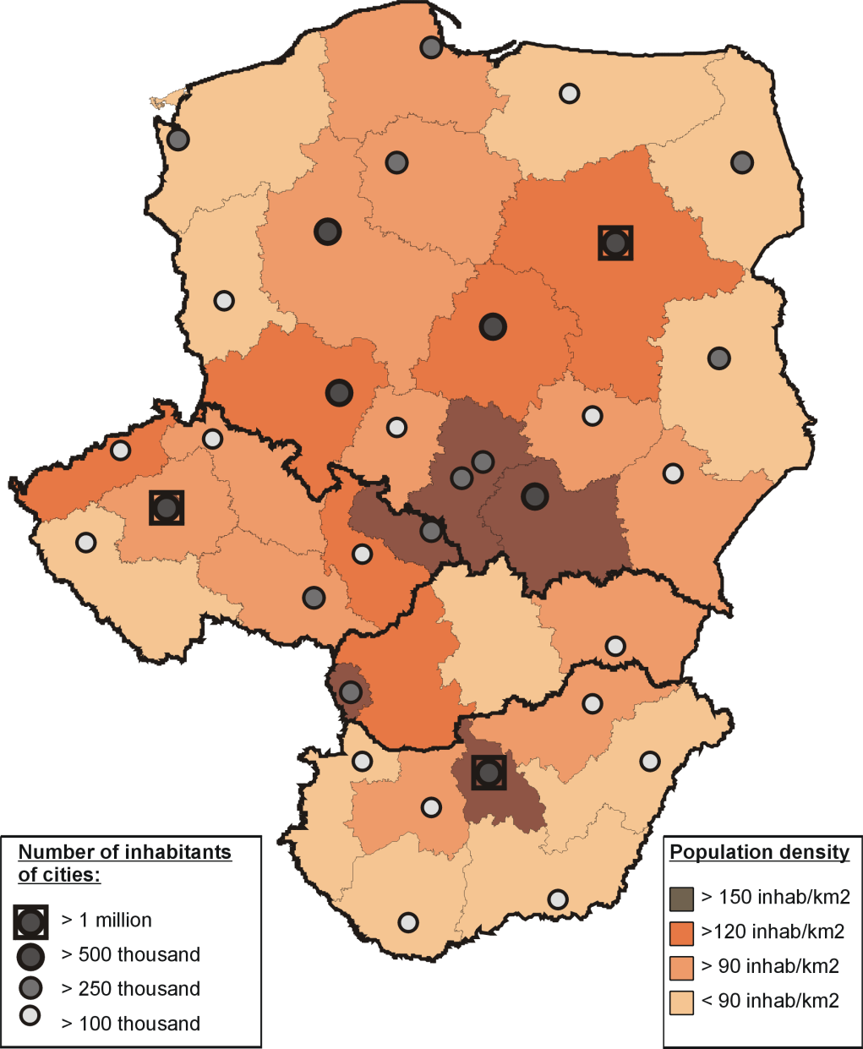
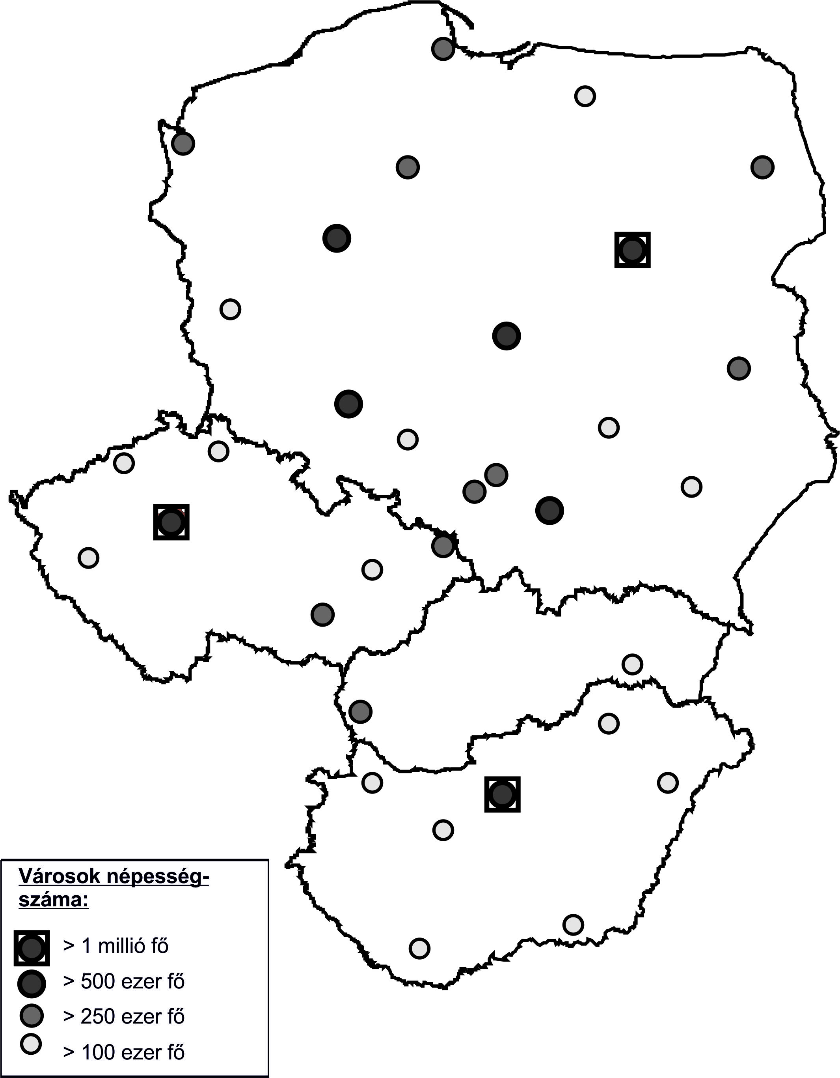
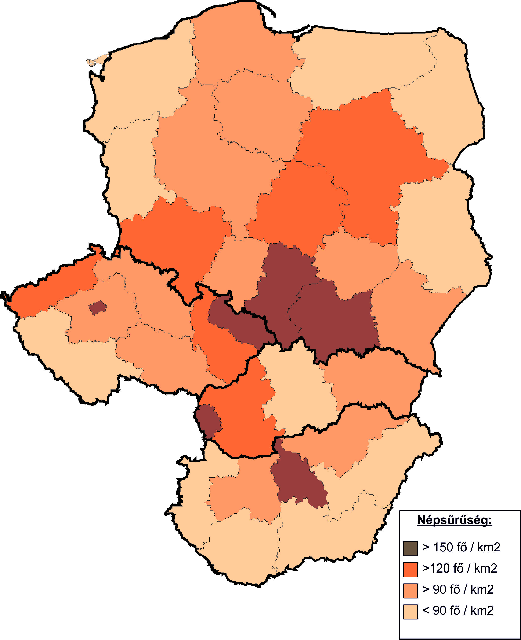
Reason of polarisation: size of regional markets!
Categories | GDP annual growth, 2000-2007, % | GDPpc in percent of EU average (PPP, 1995) | GDPpc in percent of EU average (PPP, 2010)
Population density more than 150 persons/km² | 4,25 | 75,92 | 97,00
Population density more than 120 persons/km² | 3,48 | 53,03 | 61,93
Population density more than 90 persons/km² | 3,57 | 46,45 | 51,61
Population density less than 90 persons/km² | 3,01 | 43,01 | 46,97
Source:
EUROSTAT data, own compilation .

Slide 11
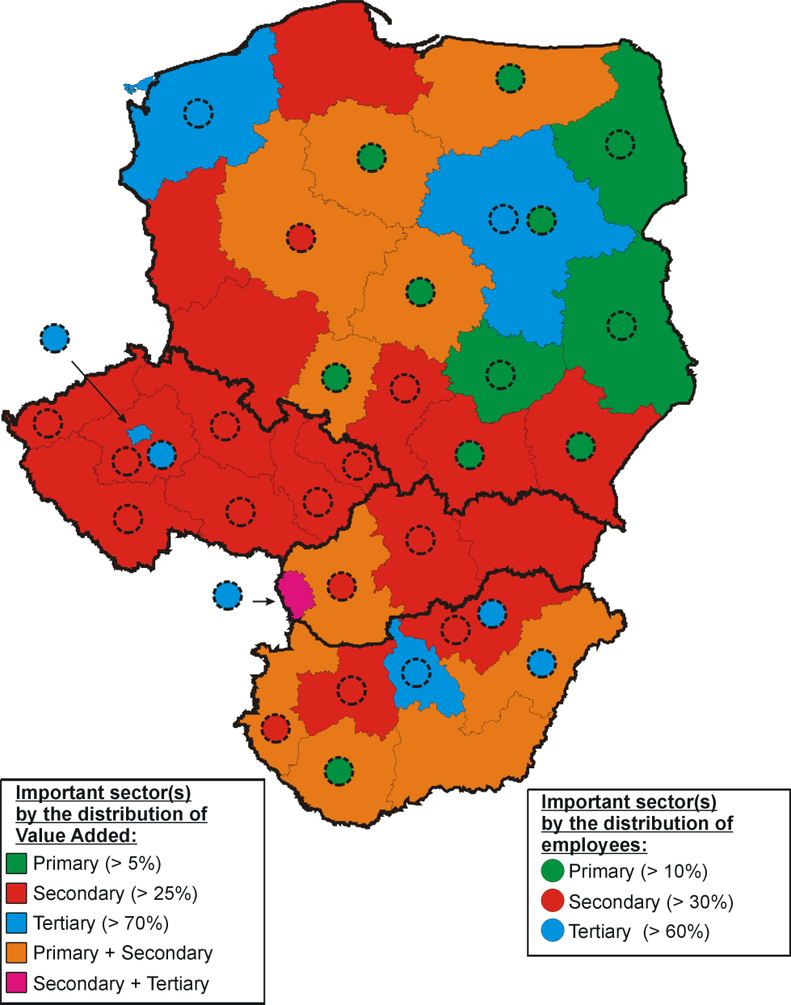
Reason of polarisation: economic structures!
Categories | GDP annual growth, 2000-2007, % | GDPpc in percent of EU average (PPP, 1995) | GDPpc in percent of EU average (PPP, 2010)
Significant primary sector | 3,17 | 39,41 | 45,95
Significant secondary sector | 3,60 | 52,51 | 57,96
Significant tertiary sector | 4,09 | 65,28 | 85,58
Source:
EUROSTAT data, own compilation .

Slide 12
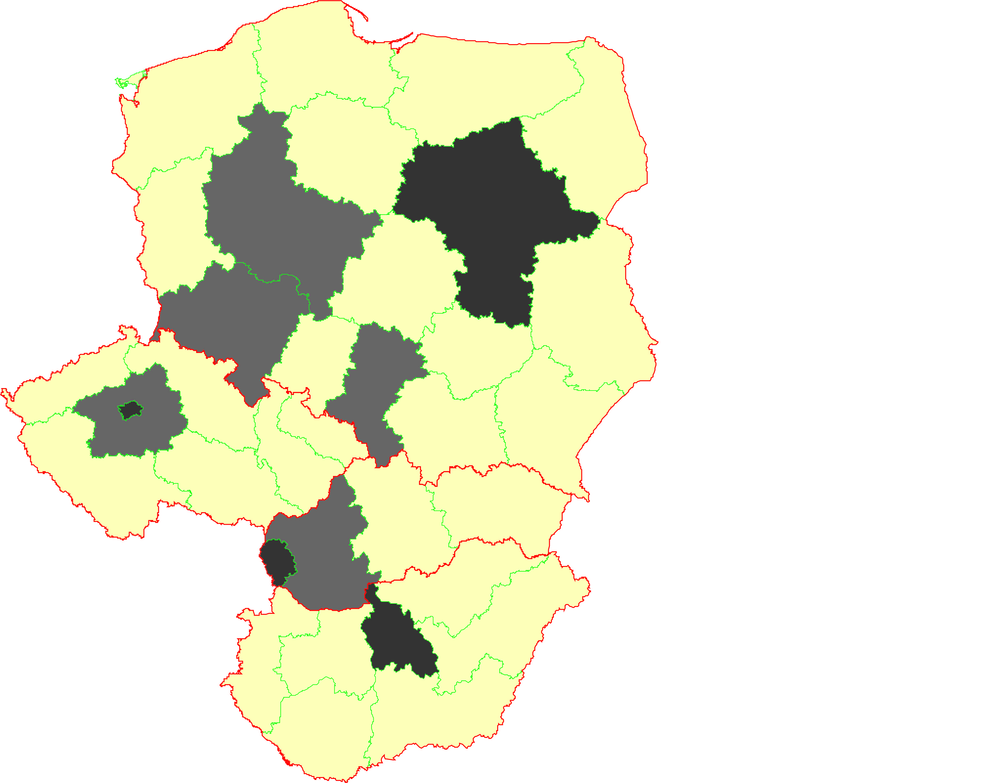
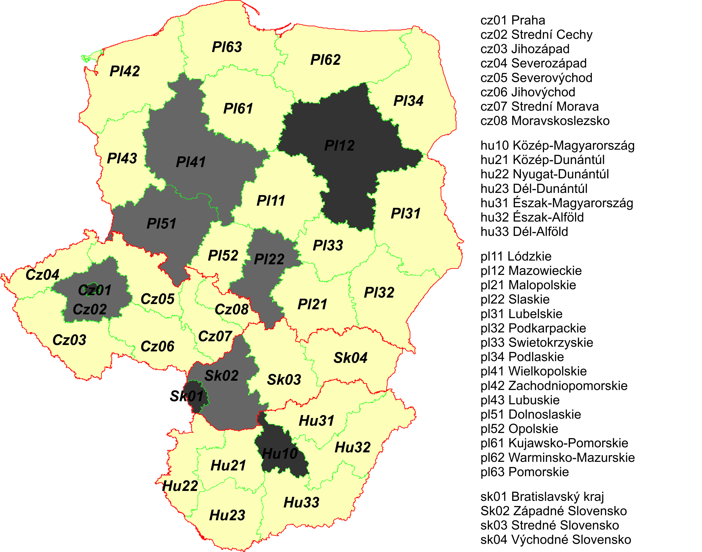
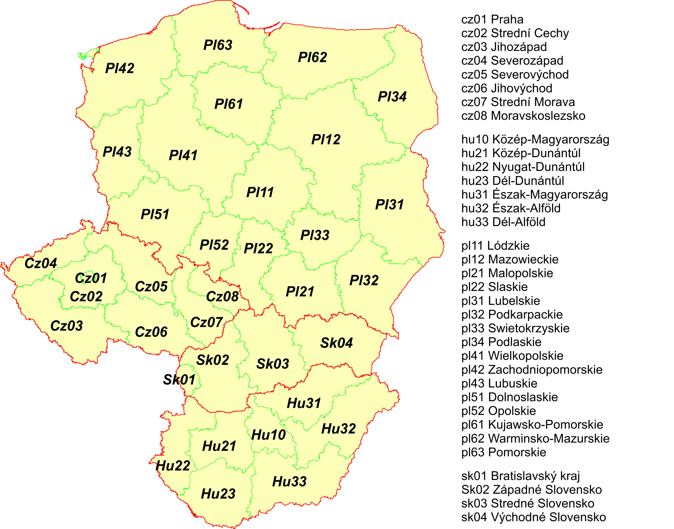
Reason of polarisation:
Considerable spatial concentration of growth factors!

Slide 13
Reason of polarisation:
Considerable spatial concentration of growth factors!
Geographical distribution of population
Name of the regions | Percent
cz01 Praha | 11,53%
cz02 Strední Cechy | 11,30%
Rest of Czech Republic | 77,18%
Total CZ | 100,00%
hu10 Közép-Magyarország | 28,34%
Rest of Hungary | 71,66%
Total HU | 100,00%
pl12 Mazowieckie | 13,52%
pl22 Slaskie | 12,28%
pl41 Wielkopolskie | 8,84%
pl51 Dolnoslaskie | 7,57%
Rest of Poland | 57,80%
Total PL | 100,00%
sk01 Bratislavský kraj | 11,20%
sk02 Západné Slovensko | 34,57%
Rest of Slovakia | 54,23%
Total SK | 100,00%
Source: EUROSTAT data, own compilation .

Slide 14
Reason of polarisation:
Considerable spatial concentration of growth factors!
Geographical distribution of settled FDI
Percent
11,53%
11,30%
77,18%
100,00%
28,34%
71,66%
100,00%
13,52%
12,28%
8,84%
7,57%
57,80%
100,00%
11,20%
34,57%
54,23%
100,00%
Name of the regions | Percent
cz01 Praha | 49,30%
cz02 Strední Cechy | 10,70%
Rest of Czech Republic | 40,00%
Total CZ | 100,00%
hu10 Közép-Magyarország | 67,70%
Rest of Hungary | 32,30%
Total HU | 100,00%
pl12 Mazowieckie | 24,30%
pl22 Slaskie | 13,50%
pl41 Wielkopolskie | 11,60%
pl51 Dolnoslaskie | 8,40%
Rest of Poland | 42,20%
Total PL | 100,00%
sk01 Bratislavský kraj | 63,20%
sk02 Západné Slovensko | 10,30%
Rest of Slovakia | 26,50%
Total SK | 100,00%
Source: EUROSTAT data, own compilation .

Slide 15
Reason of polarisation:
Considerable spatial concentration of growth factors!
Limits of creation of knowledge economy:
Population with tertiary education!
Percent
11,53%
11,30%
77,18%
100,00%
28,34%
71,66%
100,00%
13,52%
12,28%
8,84%
7,57%
57,80%
100,00%
11,20%
34,57%
54,23%
100,00%
Name of the regions | Value | Percent
cz01 Praha | 239,9 | 25,13%
cz02 Strední Cechy | 83,7 | 8,77%
Rest of Czech Republic | 630,9 | 66,10%
Total CZ | 954,5 | 100,00%
hu10 Közép-Magyarország | 508,1 | 45,25%
Rest of Hungary | 614,8 | 54,75%
Total HU | 1122,9 | 100,00%
pl12 Mazowieckie | 837,8 | 20,00%
pl22 Slaskie | 490 | 11,70%
pl41 Wielkopolskie | 331,9 | 7,92%
pl51 Dolnoslaskie | 333,2 | 7,95%
Rest of Poland | 2195,8 | 52,42%
Total PL | 4188,7 | 100,00%
sk01 Bratislavský kraj | 118,2 | 23,51%
sk02 Západné Slovensko | 148,6 | 29,55%
Rest of Slovakia | 236 | 46,94%
Total SK | 502,8 | 100,00%
Source: EUROSTAT data, own compilation .

Slide 16
Reason of polarisation:
Considerable spatial concentration of growth factors!
Limits of creation of knowledge economy:
HRST (Human resource in Science and Technology)!
Percent
11,53%
11,30%
77,18%
100,00%
28,34%
71,66%
100,00%
13,52%
12,28%
8,84%
7,57%
57,80%
100,00%
11,20%
34,57%
54,23%
100,00%
Name of the regions | Value | Percent
cz01 Praha | 397,4 | 20,75%
cz02 Strední Cechy | 197,1 | 10,29%
Rest of Czech Republic | 1321,1 | 68,96%
Total CZ | 1915,7 | 100,00%
hu10 Közép-Magyarország | 674,0 | 42,83%
Rest of Hungary | 899,5 | 57,17%
Total HU | 1573,4 | 100,00%
pl12 Mazowieckie | 1082,3 | 19,06%
pl22 Slaskie | 702,6 | 12,37%
pl41 Wielkopolskie | 446,3 | 7,86%
pl51 Dolnoslaskie | 467,8 | 8,24%
Rest of Poland | 2979,2 | 52,47%
Total PL | 5678,1 | 100,00%
sk01 Bratislavský kraj | 179,3 | 20,27%
sk02 Západné Slovensko | 288,8 | 32,65%
Rest of Slovakia | 416,5 | 47,08%
Total SK | 884,6 | 100,00%
Source: EUROSTAT data, own compilation .

Slide 17
Reason of polarisation:
Considerable spatial concentration of growth factors!
Limits of creation of knowledge economy:
GERD (Gross Expenditure on R&D)!
Percent
11,53%
11,30%
77,18%
100,00%
28,34%
71,66%
100,00%
13,52%
12,28%
8,84%
7,57%
57,80%
100,00%
11,20%
34,57%
54,23%
100,00%
Name of the regions | Value | Percent
cz01 Praha | 531,7 | 37,53%
cz02 Strední Cechy | 287,5 | 20,29%
Rest of Czech Republic | 597,8 | 42,19%
Total CZ | 1416,9 | 100,00%
hu10 Közép-Magyarország | 559,5 | 69,35%
Rest of Hungary | 247,3 | 30,65%
Total HU | 806,8 | 100,00%
pl12 Mazowieckie | 577,4 | 41,67%
pl22 Slaskie | 109,0 | 7,87%
pl41 Wielkopolskie | 108,3 | 7,81%
pl51 Dolnoslaskie | 86,1 | 6,22%
Rest of Poland | 504,9 | 36,44%
Total PL | 1385,7 | 100,00%
sk01 Bratislavský kraj | 92,5 | 47,58%
sk02 Západné Slovensko | 56,9 | 29,27%
Rest of Slovakia | 45,0 | 23,15%
Total SK | 194,4 | 100,00%
Source: EUROSTAT data, own compilation .

Slide 18
Reason of polarisation:
Considerable spatial concentration of growth factors!
Driver of the prospective growth:
GFCF (Gross Fixed Capital Formation)!
Percent
11,53%
11,30%
77,18%
100,00%
28,34%
71,66%
100,00%
13,52%
12,28%
8,84%
7,57%
57,80%
100,00%
11,20%
34,57%
54,23%
100,00%
Name of the regions | Value | Percent
cz01 Praha | 10475,0 | 28,40%
cz02 Strední Cechy | 3329,9 | 9,03%
Rest of Czech Republic | 23077,0 | 62,57%
Total CZ | 36881,9 | 100,00%
hu10 Közép-Magyarország | 6877,4 | 38,92%
Rest of Hungary | 10791,5 | 61,08%
Total HU | 17668,9 | 100,00%
pl12 Mazowieckie | 14193,8 | 20,16%
pl22 Slaskie | 8206,4 | 11,65%
pl41 Wielkopolskie | 6309,6 | 8,96%
pl51 Dolnoslaskie | 5634,0 | 8,00%
Rest of Poland | 36079,4 | 51,23%
Total PL | 70423,2 | 100,00%
sk01 Bratislavský kraj | 4776,9 | 34,49%
sk02 Západné Slovensko | 3853,6 | 27,82%
Rest of Slovakia | 5220,2 | 37,69%
Total SK | 13850,7 | 100,00%
Source: EUROSTAT data, own compilation .

Slide 19
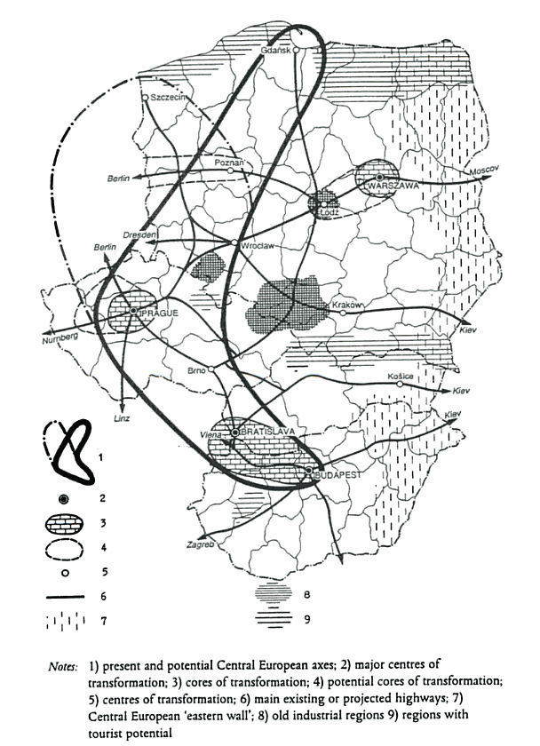
Is there nothing new under the Sun?
‘Industrial core or triangle’ from 19th century
(Budapest – Cracow/Katowice - Leipzig)
‘East European Boomerang’ from the mid-20 century
(Budapest – Prague - Gdansk)
Source: Grzegorz Gorzelak, 1996

Slide 20
Concluding remarks
Significant polarisation (due to the export oriented economic structure, high geo-concentration of industrial activities and knowledge economy).
Growing development gaps with many aspects:
  Inter- and intraregional;
  Sectoral (primary-secondary-tertiary), key role of manufacturing;
  Urban-rural (growth poles),
  Core-periphery (cases of border regions),
  Western-Eastern incline (especially in SK and HU, and not really in Poland),
  Concentration of economic activities (agglomerations).
Both endogenous and exogenous factors contributed to this differentiation!
Positive consequence of the polarisation: a few developed, competitive cities, regions in East Central Europe exist (Bratislava and Prague among the TOP 10 regions of EU in 2010 by GDPpc; Budapest and Warsawa are close to the EU average). Growth poles!
On the other hand a high number of regions is in inferior, exposed situation. An active, structure-oriented sectoral and regional policies are needed to foster them in a sustainable way!

Slide 21
Concluding remarks
The main effects of the current crisis:
  First to be stated that not homogenous on V4 countries’ economy (PL >< SK, CZ >< HU), depending on the financial status of the country and the market size.
  The main negative mechanisms vulnerating the economies are the falling volumes of export and direct investment (reduced consumption both local and foreign; reduced budget for fixed capital formation).
  The improvements (decreasing development gaps) are just apparent and illusive. Mainly thanks to the slowed down growth of cores and NOT the accelerated growth of peripheries.
  EU regional policy (with national contributions) is chance for a accelerate the catching up process in ECE.

Slide 22
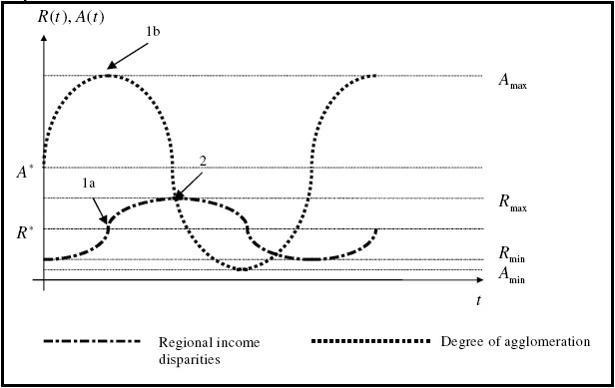
Concept on
economic growth and spatial differentiation
Trade off between interregional inequalities and
agglomeration
D. Meyer and J. Lackenbauer (2006)

Slide 23
Thank you for your attention!
Contact us:
kuttor.daniel@uni-miskolc.hu
zahorcsak.zsolt@uni-miskolc.hu
Visit the Institute:
gtk.uni-miskolc.hu/iwre

